Slide 1
Lecture 1: Introduction to Business Analytics
Prof. Mike Boyle
Department of Operations and Information Systems
University of Utah

Slide 2
What is Business Analytics (BA)?
Concept:
Outsourcing of major functions is increasing in modern businesses leaving each with a smaller set of core competencies:
How to handle internal processes
Understanding customers needs now and in the future
How to excel in these competencies?
One solution: Business Analytics (BA)
Definition of BA: “Delivering the right decision to support the right people at the right time”*
* Laursen, G. and Thorlund, J., “Business Analytics for Managers” Wiley, 2010

Slide 3
Three Pillars of BA
BA Program/Competency
Concept: BA Maturity Level is a function of the organization’s maturity levels for each of the three pillars:
Information Management
Analysis
Culture/Leadership
Information Management Competency
Analysis Competency
Culture/Leadership

Slide 4
What is Business Analytics (BA)? (cont’d)
Related Terminology:
Business Intelligence: systems, skills, processes, methods to support decision-making
Analytics: the process of obtaining an optimal or effective decisions based on existing data
Big Data (simple definition): data/processing that it too large to for a single machine
Big Data: Analytics practices applied to data that has one or more of the following properties:
High Volume
High Variety
High Velocity
Hadoop: An open-source software framework for storage and large-scale processing of data-sets on clusters of commodity hardware*
Data Science: “…refers to an emerging area of work concerned with the collection, preparation, analysis, visualization, management and preservation of large collections of information”**
Data Scientist: Person who is better at statistics than any software engineer and better at software engineering than any statistician.***
* http://en.wikipedia.org/wiki/Apache_Hadoop, accessed 2014/08/25
** Jeffrey Stanton, Syracuse University School of Information Studies
*** Josh Wills, https://twitter.com/josh_wills/status/198093512149958656, accesses 2014/08/25

Slide 5
What is Business Analytics (BA)? (cont’d)
Other names for/forms of Business Analytics
Business Intelligence
Analytics/Advanced Analytics/Predictive Analytics/Predictive Modeling
[Web|Digital|Social|Mobile|Customer|etc.] Analytics
[Business|Strategic] Analysis
FP&A (Financial Planning & Analytics)
Data mining/Data visualization
(others)

Slide 6
What is Business Analytics (BA)? (cont’d)
Required elements for BA as an Information System:
Information Technology
Human competencies
Data management
Analysis
Communication
Data-driven culture
Business process that makes use of information
Recall the “3 pillars” of BA

Slide 7
BA in the organization
Organization (viewed as a set of primary/secondary processes and competencies)
Primary Process 1
Competencies
Secondary Process 1
Secondary Process n
BA Process n
BA Process 1
Note: not all primary and secondary processes are supported by BA

Slide 8
BA in the organization (cont’d)
Manufacturing Organization (viewed as a set of primary/secondary processes and competencies)
BA programs can be relatively effectively deployed when viewed as this abstraction
Discussion: Why is abstraction important?
Reduces complexity in analysis and communication
Discussion: What are some challenges of this view of the organization?
Organizations typically have departments but processes often span departments
E.g. 1) acquire raw materials; 2) manufacture products; 3) warehouse products; 4) sell products;
Manufacturing, Warehouse Mgmt, Marketing, IT, Analysis, HR, etc.
Maintain machinery
Training
Customer satisfaction analysis
Machine performance reporting

Slide 9
How BA creates value
Efficiency gains to processes
E.g. use fewer inputs
E.g. use same level of inputs more efficiently to create more/better outputs
Reduction of effects from Cognitive Biases
Providing users of the process with added value
E.g. Mining customer data provides information not previously available to the organization and/or competition

Slide 10
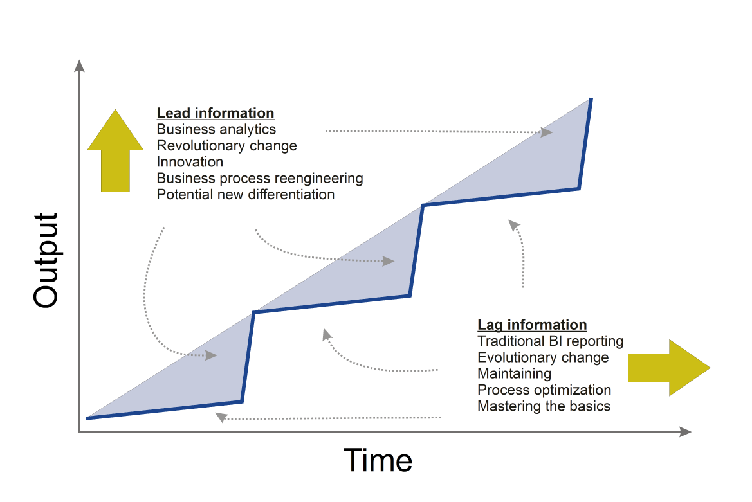
Lead and Lag Information in BA
Discussion: Provide an example of a change based on lead information
E.g. change based on a predictive model
Discussion: Provide an example of a change based on lag information
E.g. change based on a report
Image Source: Laursen, G. and Thorlund, J., “Business Analytics for Managers” Wiley, 2010

Slide 11
BA and Cognitive Biases
BA makes decision-making more effective, in general, by reducing the effects of various Cognitive Biases
Anchoring effect
Relying too heavily on one dimension
Bandwagon effect
Influenced by popular belief/action
Confirmation bias
Searching/interpreting in a way that matches preconception
False consensus bias
Overestimating how much everyone else is like oneself

Slide 12
BA and Cognitive Biases (cont’d)
Mere exposure effect
Bias toward something that one is familiar with
Recency effect
More recent information/events weigh more heavily in decision compared to less recent information/events
Sunk cost fallacy
Influenced by prior investments with the expectation that they can be made relatively more successful
Loss aversion
People value not losing more than winning
Omission bias
People judge harmful actions to be relatively worse than harmful omissions (i.e. non-actions) all else being equal

Slide 13
BA and Cognitive Biases (cont’d)
Discussion: Consider a recent group decision in which you were a participant
Which cognitive biases were your colleagues affected by?
Which cognitive biases were you affected by?

Slide 14
BA: Current State
"Analytics in Action: Breakthroughs and Barriers to ROI.” Accenture, 2013
Background:
600 interviews; Aug-Sept 2012; US and UK
Director-level execs and equivalent managers with analytics responsibilities/knowledge; 1000+ employees
Highlights:
33% of companies are aggressively using analytics across the enterprise
68% of sr. mgmt teams engaged with and committed to analytics and fact-based decision-making
66% of firms have appointed a sr. figure such as a “Chief Data Officer” to lead data management in the last 18 months
Fewer participants than in 2009 state that their use of analytics is hindered by lack of data, technology, analytical skills and/or sr. mgmt support
25% of respondents “to a great extent” see data as an increasingly valuable source for generating new ideas and opportunities (up from 12% in 2009)

Slide 15
BA: Current State (cont’d)
"Analytics in Action: Breakthroughs and Barriers to ROI.” Accenture, 2013
Highlights (cont’d):
Most analytics implementations are tactically focused
Only 20% of organizations claim to have a good performance management capability have any causal link between what they measure and the outcomes they are intending to drive
Increase in using external analysts/consultants to source analytics projects (59% in 2012; 53% in 2009)
35% of firms report some degree of satisfaction with analytics only 22% state they are “very” satisfied

Slide 16
BA: Current State (cont’d)
Articles, papers and sources on current state of BA:
LaValle et al, “Big Data, Analytics and the Path From Insights to Value”, MIT Sloan Management Review (2011)
McCarthy et al, “Getting Serious About Analytics: Better Insights, Better Outcomes”, Accenture (2011)
"Big data: The next frontier for innovation, competition, and productivity." (2011)
information-management.com
datasciencecentral.com
Conferences/communities
O’Reilly Strata Conference
TDWI.org (The Data Warehouse Institute)
Predictive Analytics World
(various linked in groups)
Competitions
kaggle.com
KDD Cup
innocentive.com

Slide 17
The Information Strategy
“…basically a plan of what your BA department should focus on according to your company strategy.”*
* Laursen, G. and Thorlund, J., “Business Analytics for Managers” Wiley, 2010

Slide 18
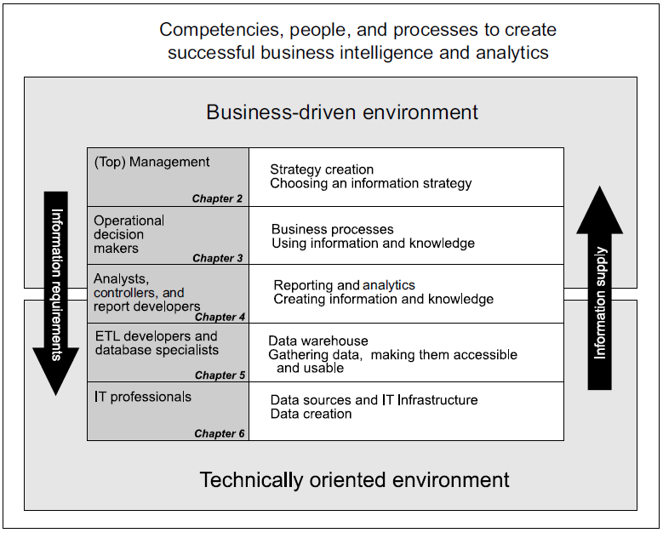
The Business Analytics Model (BAM)

Slide 19
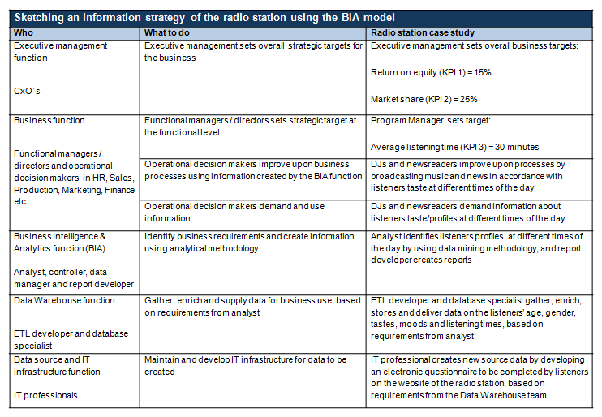
Information Strategy Sketch Framework: Radio Station Example
Source: Laursen, G. and Thorlund, J., “Business Analytics for Managers” Wiley, 2010

Slide 20
Recall: BAM
Recall how the in the “Radio Station Example” the Information Requirements flow from the Business-driven Environment to the Technically oriented environment and back up

Slide 21
BA Maturity framework
Maturity Level | Focus areas and characteristics | Characteristics of Information System | Processes | Competencies
4 | Focus on optimizing Information System Better and cheaper information and knowledge Pervasive BA | Automated systems push Lead and Lag Information to users | Lead and Lag Information accessible to both Sr. Mgmt and Operational processes | Competencies that optimize processes based on strategic business and analytical insight
3 | Focus on generating Lead Information Large amounts of information; medium amounts of knowledge; some automation | Analytical competencies support a systemized generation of Lead Information On-demand distribution of Lag Information | Sr. Mgmt processes are supported by Lead Information Operational processes are supported by Lag Information | Analytical competencies with sound business insight
2 | Focus on generating Lag Information Medium amounts of information; small amounts of knowledge | Data combined in a data warehouse Reporting systems established | Key people have access to Lag Information Analysts spend most of their time generating reports and lists | Data warehouse competencies with basic analytical knowledge
1 | No focus on BI Large amounts of data; small amounts of information | Built on source data and fragmented data islands | Very few “power users” Difficult to access information Few analytical competencies | Varying IT competencies
Source: Laursen, G. and Thorlund, J., “Business Analytics for Managers” Wiley, 2010

Slide 22
BA Maturity example
Maturity Level | Focus areas and characteristics | Characteristics of Information System | Processes | Competencies
4 | Focus on optimizing Information System Better and cheaper information and knowledge Pervasive BA | Automated systems push Lead and Lag Information to users | Lead and Lag Information accessible to both Sr. Mgmt and Operational processes | Competencies that optimize processes based on strategic business and analytical insight
3 | Focus on generating Lead Information Large amounts of information; medium amounts of knowledge; some automation | Analytical competencies support a systemized generation of Lead Information On-demand distribution of Lag Information | Sr. Mgmt processes are supported by Lead Information Operational processes are supported by Lag Information | Analytical competencies with sound business insight
2 | Focus on generating Lag Information Medium amounts of information; small amounts of knowledge | Data combined in a data warehouse Reporting systems established | Key people have access to Lag Information Analysts spend most of their time generating reports and lists | Data warehouse competencies with basic analytical knowledge
1 | No focus on BI Large amounts of data; small amounts of information | Built on source data and fragmented data islands | Very few “power users” Difficult to access information Few analytical competencies | Varying IT competencies
Source: Laursen, G. and Thorlund, J., “Business Analytics for Managers” Wiley, 2010

Slide 23
Appendix

